Slide 1
Election Forecasting
using Linear Regression
Gene Lam

Slide 2
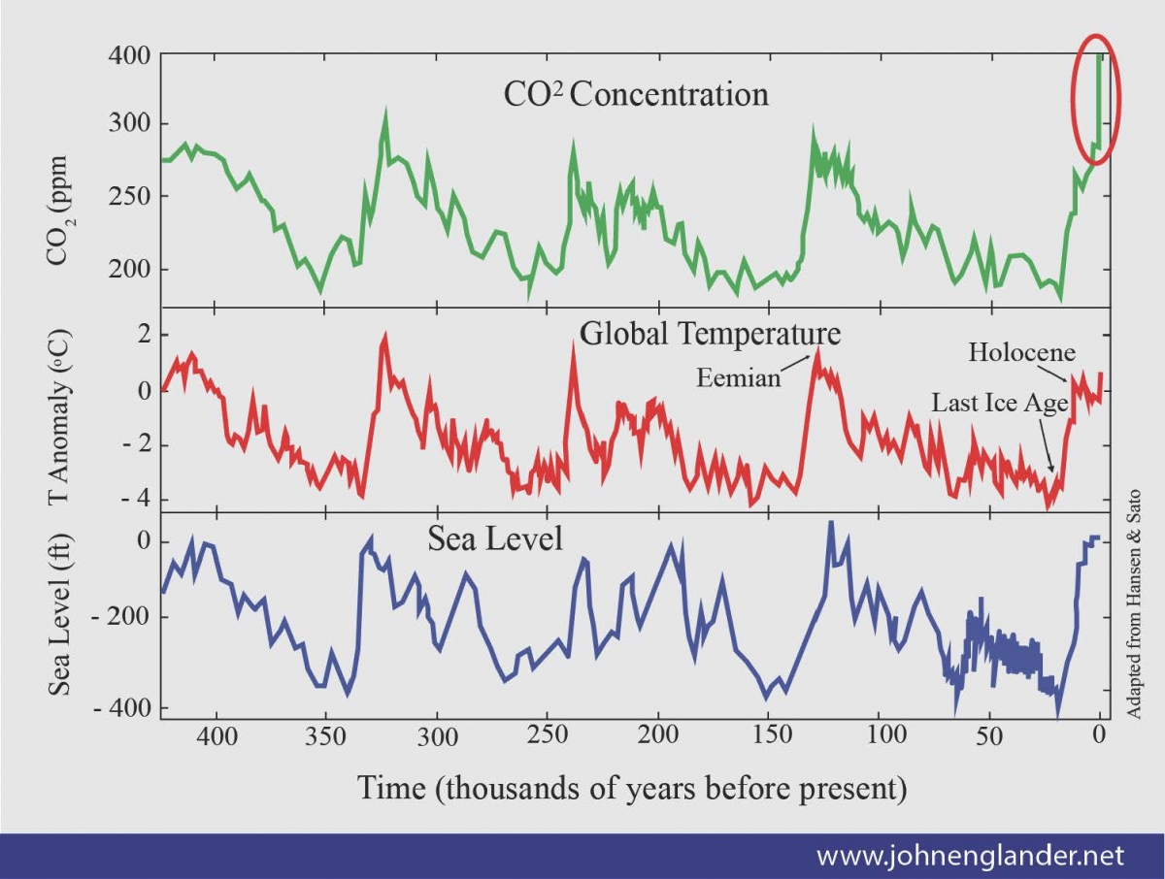
Regression Analysis
Regression is a set of tools used to analyze the relationship between two or more variables
Notes:
This makes regression analysis incredibly useful for creating models that depict relationships between multiple agents. Note that just because there may be a relationship, that doesn’t necessarily indicate causality.

Slide 3
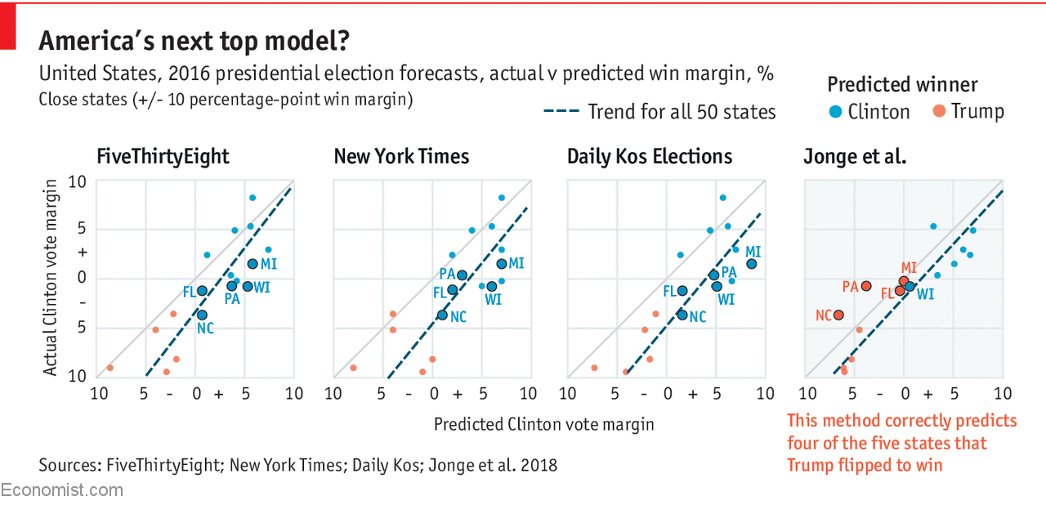
Election Modeling (2016)
When it comes to election modeling, there is a lot at stake...
Notes:
These models are used to inform the public on what to expect, and provide meaningful insight into effective strategies for politicians and their campaigns. However, models aren’t perfect. In 2016, Hillary Clinton was predicted to be the first female President in a majority of notable forecasts. These models took data from polls, which is also imperfect as many people didn’t want to admit to voting for Donald Trump. After the election, these models were updated to give more weight to uneducated voters.

Slide 4
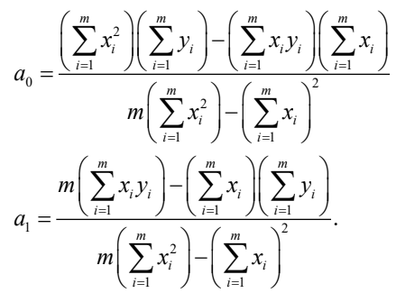
Methodology
Purpose: To predict who will win the 2020 election
Assume linear regression model
Two parameters:
voter-base engagement
third-party engagement
Method of Least Squares
ΔY = β₀x₀ + β₁x₁ + β₂
ΔY = change in % total votes
β₀ = voter-base correlation coefficient
β₁ = third-party correlation coefficient
β₂ = constant
Notes:
To gain more insight into election modeling, we use a simple linear regression model consisting of two variables: how likely you are to retain your current base, and how likely you are to persuade third-party voters.

Slide 5
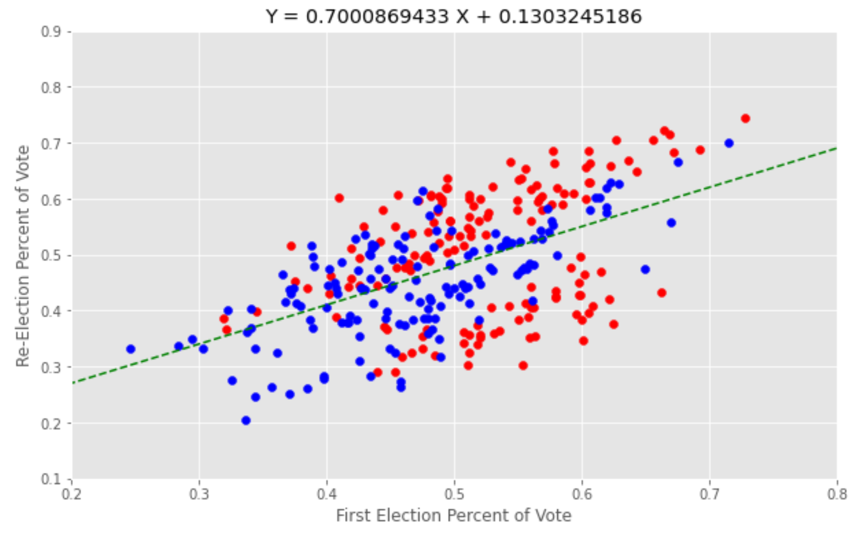
Determining Coefficient β₀, voter base correlation
 | Election Year | Re-election Year
Jimmy Carter* | 1976 | 1980
Ronald Reagan | 1980 | 1984
George H.W. Bush* | 1984 | 1988
Bill Clinton | 1992 | 1996
George W. Bush | 2000 | 2004
Barack Obama | 2008 | 2012
Donald Trump | 2016 | 2020
First we plot a candidate’s first election turnout against their re-election turn out.
* signifies one-term presidency
Notes:
It seems like there’s a strong positive correlation between voting preferences in a President’s first race and re-election race, which makes sense as people tend to support the candidate of the same party that they voted for in previous elections.

Slide 6
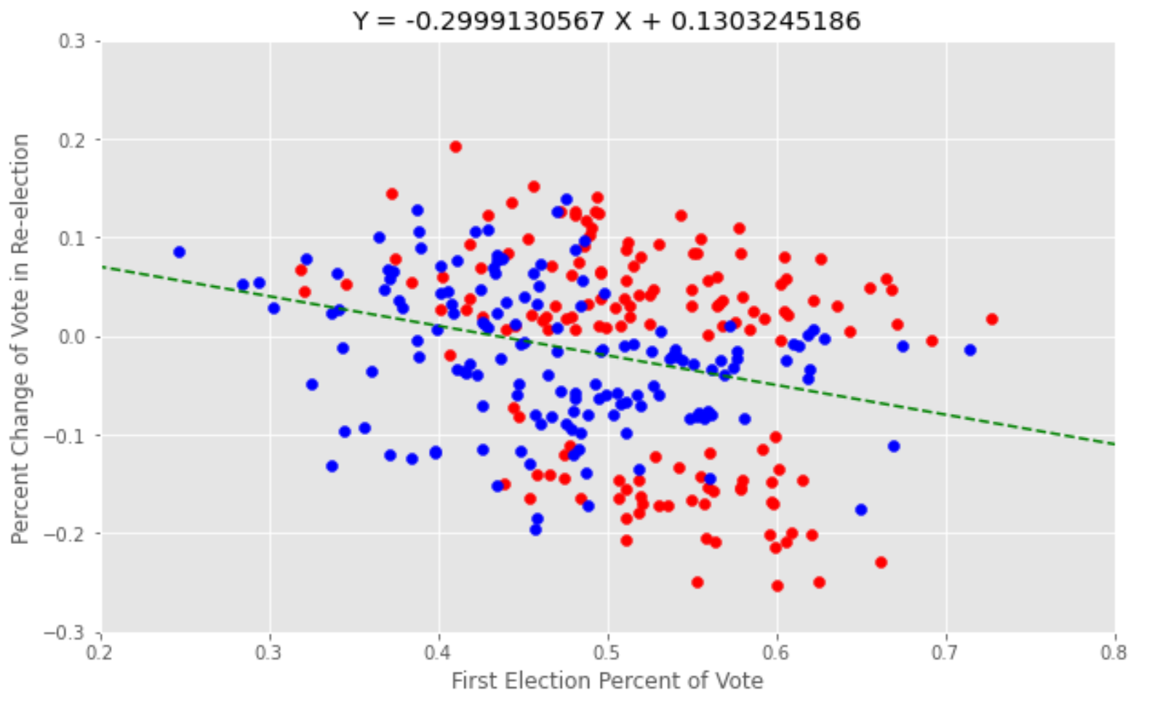
Determining Coefficient β₀, voter base correlation
Coefficient β₀ is the slope of the change in turnout from a candidate’s first election.
Notes:
This graph was generated by subtracting the number of re-election and election votes. What this tells us is there isn’t much of a change in turnout rate if a presidential candidate runs again for re-election. If anything, there’s a slight negative correlation in turnout rate.

Slide 7
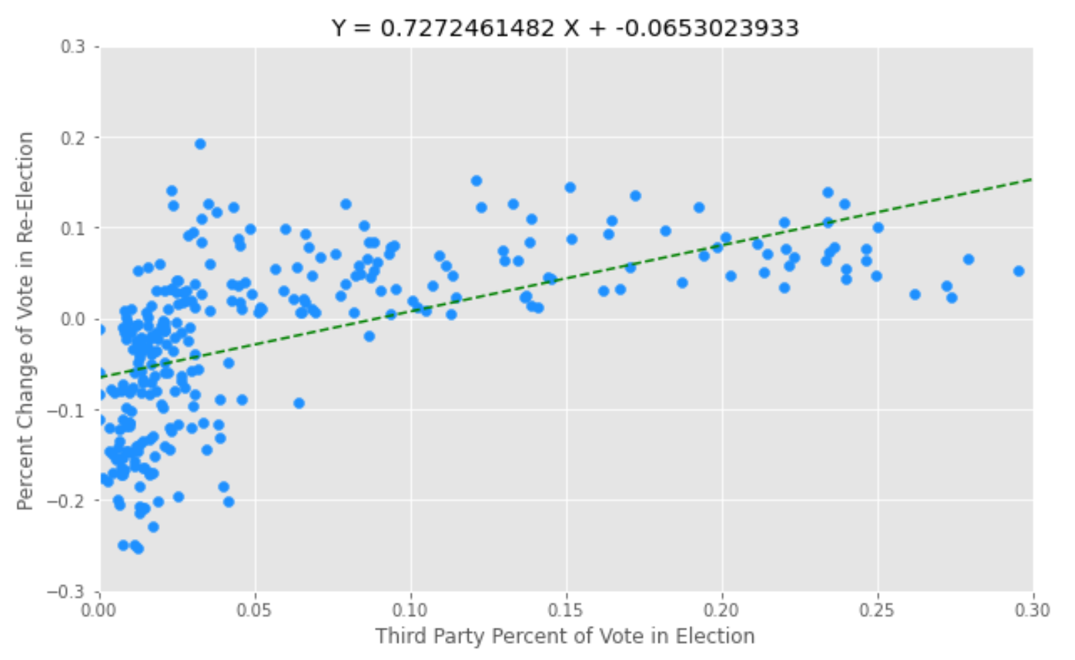
Coefficient β₁ is the slope of the change in turnout vs. third-party voter turnout
Notes:
I used the same technique to find the third-party voter correlation. Notice that the line of best fit doesn’t properly match our data. It seems like if there was a low turnout in a candidates election, they will be more likely to lose voters in the reelection. The data is depicted in a logarithmic curve. In statistics, we would have to reject the hypothesis and use a different regression model. In this case, however, I will continue to use our regression equation.

Slide 8
Combining our results:
ΔY₁ = -0.2999x₀ + 0.1303
ΔY₂ = 0.7272x₁ + -0.0653
ΔY = -0.2999x₀ + 0.7272x₁ + 0.065
where x₀ is the average voter base turnout and x₁ is the average third party turnout in DJT’s first election
Notes:
l added the two linear regression equations together to come up with my final model. I found the mean percent of votes for Donald Trump in the first election and substituting that in as x0, as well as the the mean third-party percent of votes into x1.

Slide 9
Model Results
Joe Biden won the 2020 election with a predicted vote of 49.8%.
 | Vote % | Predicted Vote % | Absolute Error | Relative Error | Electoral Votes | Vote Count
Donald J. Trump | 46.8% | 45.99% | 1.113 | 0.024 | 232 | 74,222,484
Joe Biden | 51.3% | 49.81% | 1.292 | 0.025 | 306 | 81,282,896
Notes:
And I got the predicted vote for DJT. I then subtracted his vote from 100 and a margin for third party voters to get Biden’s predicted vote, as well as the absolute and relative errors

Slide 10
Predicted Margin of Win: -3.82%
The win/lose margin is in line with other Presidential elections.
Incumbent | Challenger | Margin of Win
George H.W. Bush | Bill Clinton | -5.6%
Bill Clinton | Robert Dole | 8.5%
George W. Bush | John Kerry | 2.4%
Barack Obama | Mitt Romney | 3.9%
Donald J. Trump | Joe Biden | -4.5%
Notes:
Although our margin of win is similar to other historical margins, I just want to note that these elections can get extremely tight so being able to create more robust, and accurate models is important to predicting who gets to represent us in government

Slide 11
Limitations
Overly simplified, merely an estimate
Doesn’t take into account:
Increased turnout from current events
Covid-related impacts to campaigning
Increased volumes of mail-in ballots
Increasing distrust in institutions, elections, and media
Public opinion on the economy

Slide 12
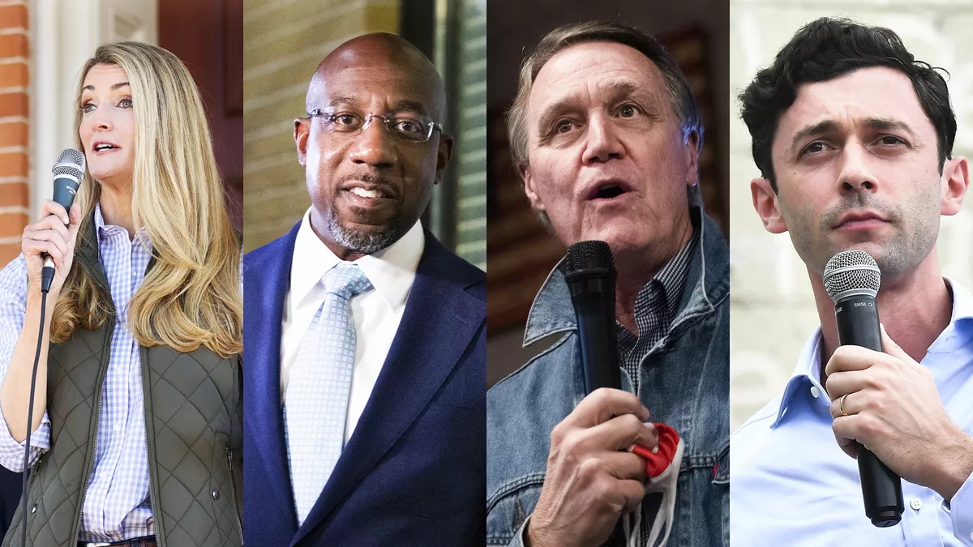
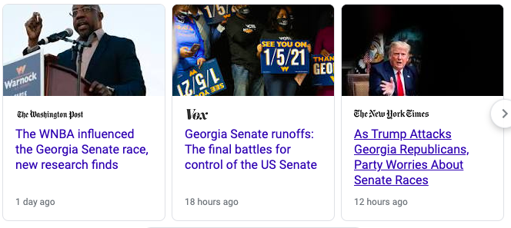
Applications in the Georgia Senate Race
Due to Georgia’s Election laws, the Georgia Senate races will be held in a runoff on January 5
I used the same algorithm to develop a new regression model for the senate race...

Slide 13
Model Results and Limitations
 | Predicted Vote %
David Purdue | 48.89%
Jon Ossoff | 50.05%
I was only able to apply my code on the George regular senate race runoff
A different application would have to take into account the multiple Democrats and Republicans facing off in the special election
Notes:
Note that the Georgia regular election model is more prone to error because my dataset was smaller than the one I used for the President model.

Slide 14
Next Steps
Improve the model by...
Applying statistical analysis to account for third-party error
Accounting for other factors like polling, the economy, public safety, etc

Slide 15
Sources
U.S. President 1976-2016 and U.S. Senate 1976-2018 Dataset from https://electionlab.mit.edu/data
Election outcomes from Wikipedia
Method of Least Squares formula from SP 22 Approximation Theory
Global Warming, 2016 Election Forecasts, and Georgia Senate Race images from Google
Inspiration from Cezary Klimczuk, who used voter base and third-party turnout to simulate Poland’s Presidential elections https://towardsdatascience.com/how-i-predicted-the-election-result-with-simple-linear-regression-e54c6c196239

